Slide 1
Functional Units of a Computer

Slide 2
FUNCTIONAL UNITS OF COMPUTER
Input Unit
Output Unit
Central processing Unit (ALU and Control Units)
Memory
Bus Structure

Slide 3
The Big Picture
Processor
Input
Control
Memory
ALU
Output
Since 1946 all computers have had 5 components!!!

Slide 4
Function
IMPORTANT SLIDE !
ALL computer functions are:
Data PROCESSING
Data STORAGE
Data MOVEMENT
CONTROL
NOTHING ELSE!
Data = Information
Coordinates How Information is Used

Slide 5
INPUT UNIT:
Converts the external world data to a binary format, which can be understood by CPU
Eg: Keyboard, Mouse, Joystick etc
OUTPUT UNIT:
Converts the binary format data to a format that a common man can understand
Eg: Monitor, Printer, LCD, LED etc

Slide 6
CPU
The “brain” of the machine
Responsible for carrying out computational task
Contains ALU, CU, Registers
ALU Performs Arithmetic and logical operations
CU Provides control signals in accordance with some timings which in turn controls the execution process
Register Stores data and result and speeds up the operation

Slide 7
Example
Add R1, R2
T1
T2
T3
T4
Enable R1
Enable R2
Enable ALU for addition operation
Enable out put of ALU to store result of the operation

Slide 8
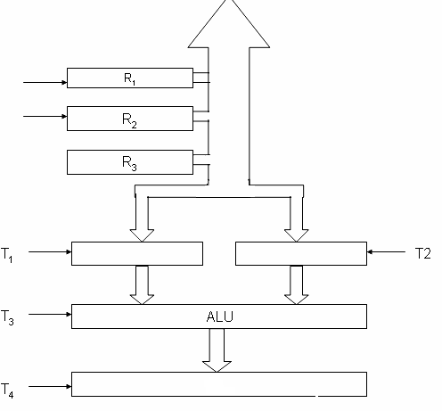
Control unit works with a reference signal called processor clock
Processor divides the operations into basic steps
Each basic step is executed in one clock cycle
T1
T2
R1
R2
R2

Slide 9
MEMORY
Stores data, results, programs
Two class of storage
(i) Primary (ii) Secondary
Two types are RAM or R/W memory and ROM read only memory
ROM is used to store data and program which is not going to change.
Secondary storage is used for bulk storage or mass storage

Slide 10
Basic Operational Concepts
Basic Function of Computer
To Execute a given task as per the appropriate program
Program consists of list of instructions stored in memory

Slide 11
Review
Activity in a computer is governed by instructions.
To perform a task, an appropriate program consisting of a list of instructions is stored in the memory.
Individual instructions are brought from the memory into the processor, which executes the specified operations.
Data to be used as operands are also stored in the memory.

Slide 12
A Typical Instruction
Add LOCA, R0
Add the operand at memory location LOCA to the operand in a register R0 in the processor.
Place the sum into register R0.
The original contents of LOCA are preserved.
The original contents of R0 is overwritten.
Instruction is fetched from the memory into the processor – the operand at LOCA is fetched and added to the contents of R0 – the resulting sum is stored in register R0.

Slide 13
Separate Memory Access and ALU Operation
Load LOCA, R1
Add R1, R0
Whose contents will be overwritten?

Slide 14
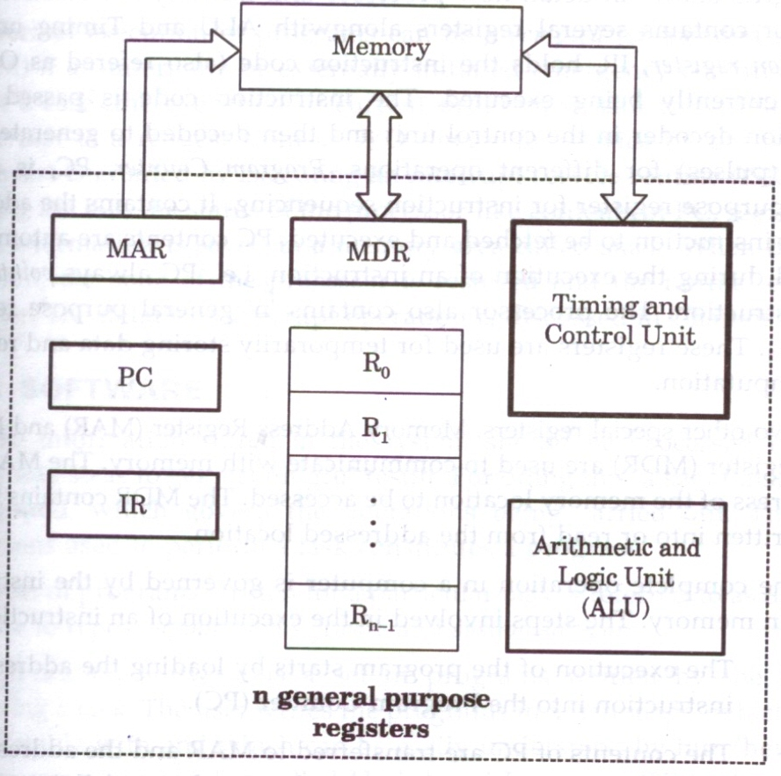
Interconnection between Processor and Memory

Slide 15
Registers
Registers are fast stand-alone storage locations that hold data temporarily. Multiple registers are needed to facilitate the operation of the CPU. Some of these registers are
Two registers-MAR (Memory Address Register) and MDR (Memory Data Register) : To handle the data transfer between main memory and processor. MAR-Holds addresses, MDR-Holds data
Instruction register (IR) : Hold the Instructions that is currently being executed
Program counter: Points to the next instructions that is to be fetched from memory

Slide 16
(PC) (MAR)( the contents of PC transferred to MAR)
(MAR) (Address bus) Select a particular memory
location
Issues RD control signals
Reads instruction present in memory and loaded into MDR
Will be placed in IR (Contents transferred from MDR to IR)

Slide 17
Instruction present in IR will be decoded by which processor understand what operation it has to perform
Increments the contents of PC by 1, so that it points to the next instruction address
If data required for operation is available in register, it performs the operation
If data is present in memory following sequence is performed

Slide 18
Address of the data MAR
MAR select memory location where is issued RD signal
Reads data via data bus MDR
From MDR data can be directly routed to ALU or it can be placed in register and then operation can be performed
Results of the operation can be directed towards output device, memory or register
Normal execution preempted (interrupt)

Slide 19
Interrupt
An interrupt is a request from I/O device for service by processor
Processor provides requested service by executing interrupt service routine (ISR)
Contents of PC, general registers, and some control information are stored in memory .
When ISR completed, processor restored, so that interrupted program may continue

Slide 20
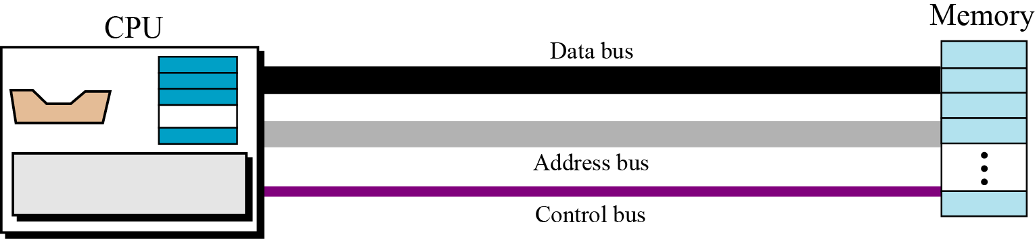
BUS STRUCTURE
Connecting CPU and memory
The CPU and memory are normally connected by three groups of connections, each called a bus: data bus, address bus and control bus
Connecting CPU and memory using three buses

Slide 21
BUS STRUCTURE
Group of wires which carries information form CPU to peripherals or vice – versa
Single bus structure: Common bus used to communicate between peripherals and microprocessor
SINGLE BUS STRUCTURE
INPUT
MEMORY
PROCESSOR
OUTPUT

Slide 22
Continued:-
To improve performance multibus structure can be used
In two – bus structure : One bus can be used to fetch instruction other can be used to fetch data, required for execution.
Thus improving the performance ,but cost increases

Slide 23
CONTROL BUS
A₂ | A₁ | A₀ | Selected location
0 | 0 | 0 | 0th Location
0 | 0 | 1 | 1st Location
0 | 1 | 0
0 | 1 | 1
1 | 0 | 0
1 | 0 | 1
1 | 1 | 0
1 | 1 | 1
W/R
CS
RD
A0
A1
A2
PROCESSOR
ADDRESS BUS
D7
D0
D0
D7
DATA BUS

Slide 24
Cont:-
2³ = 8 i.e. 3 address line is required to select 8 location
In general 2^{x} = n where x number of address lines (address bit) and n is number of location
Address bus : unidirectional : group of wires which carries address information bits form processor to peripherals (16,20,24 or more parallel signal lines)

Slide 25
Cont:-
Databus: bidirectional : group of wires which carries data information bit form processor to peripherals and vice – versa
Controlbus: bidirectional: group of wires which carries control signals form processor to peripherals and vice – versa
Figure below shows address, data and control bus and their connection with peripheral and microprocessor

Slide 26
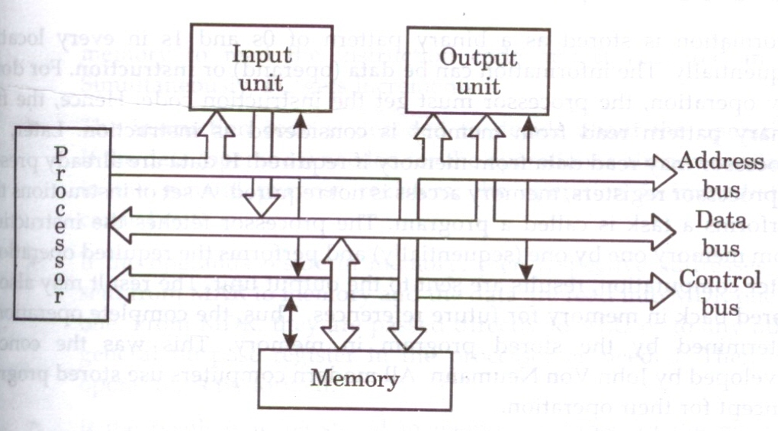
Single bus structure showing the details of connection

Slide 27
Memory Locations, Addresses, and Operations
Notes:
27

Slide 28
Memory Location, Addresses, and Operation
n
bits
Memory consists of many millions of storage cells, each of which can store 1 bit.
Data is usually accessed in n-bit groups. n is called word length.
first word
second word
•
•
•
i
th word
•
•
•
last word
Figure 2.5. Memory words.
Notes:
28

Slide 29
MEMORY LOCATIONS AND ADDRESSES
Main memory is the second major subsystem in a computer. It consists of a collection of storage locations, each with a unique identifier, called an address.
Data is transferred to and from memory in groups of bits called words. A word can be a group of 8 bits, 16 bits, 32 bits or 64 bits (and growing).
If the word is 8 bits, it is referred to as a byte. The term “byte” is so common in computer science that sometimes a 16-bit word is referred to as a 2-byte word, or a 32-bit word is referred to as a 4-byte word.

Slide 30
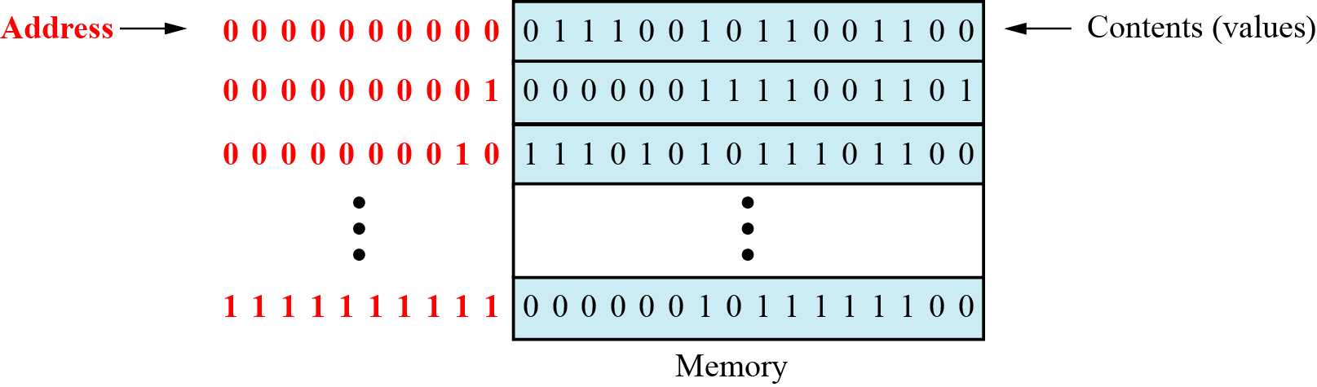
Figure 5.3 Main memory

Slide 31
Address space
To access a word in memory requires an identifier. Although programmers use a name to identify a word (or a collection of words), at the hardware level each word is identified by an address.
The total number of uniquely identifiable locations in memory is called the address space.
For example, a memory with 64 kilobytes (16 address line required) and a word size of 1 byte has an address space that ranges from 0 to 65,535.

Slide 32
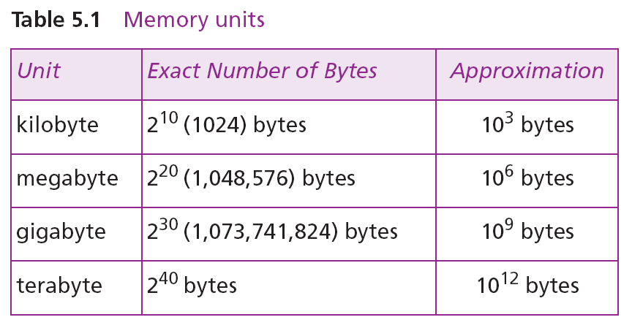

i
Memory addresses are defined using unsigned binary integers.

Slide 33
Example 1
A computer has 32 MB (megabytes) of memory. How many bits are needed to address any single byte in memory?
Solution
The memory address space is 32 MB, or 2²⁵ (2⁵ × 2²⁰). This means that we need log₂ 2²⁵, or 25 bits, to address each byte.
Example 2
A computer has 128 MB of memory. Each word in this computer is eight bytes. How many bits are needed to address any single word in memory?
Solution
The memory address space is 128 MB, which means 2²⁷. However, each word is eight (2³) bytes, which means that we have 2²⁴ words. This means that we need log₂ 2²⁴, or 24 bits, to address each word.

Slide 34
MEMORY OPERATIONS
Today, general-purpose computers use a set of instructions called a program to process data.
A computer executes the program to create output data from input data
Both program instructions and data operands are stored in memory
Two basic operations requires in memory access
Load operation (Read or Fetch)-Contents of specified memory location are read by processor
Store operation (Write)- Data from the processor is stored in specified memory location

Slide 35
Assignment of Byte Address
Big-endian and little-endian are terms that describe the order in which a sequence of bytes are stored in computer memory. Big-endian is an order in which the "bigend" (most significant value in the sequence) is stored first (at the lowest storage address).

Slide 36
Assignment of byte addresses
Little Endian (e.g., in DEC, Intel)
» low order byte stored at lowest address
» byte0 byte1 byte2 byte3
Eg: 46,78,96,54 (32 bit data)
H BYTE L BYTE
8000
8001
8002
8003
8004
54
96
78
46
|

Slide 37
Big Endian
Big Endian (e.g., in IBM, Motorolla, Sun, HP)
» high order byte stored at lowest address
» byte3 byte2 byte1 byte0
Programmers/protocols should be careful when transferring binary data between Big Endian and Little Endian machines

Slide 38
Big-Endian and Little-Endian Assignments
Big-Endian: lower byte addresses are used for the most significant bytes of the word
Little-Endian: opposite ordering. lower byte addresses are used for the less significant bytes of the word
W
ord
address
Byte address
Byte address
0
0
1
2
3
0
3
2
1
0
4
4
5
6
7
4
7
6
5
4
•
•
•
•
•
•
2
k
-
4
2
k
-
4
2
k
-
3
2
k
-
2
2
k
-
1
2
k
-
4
2
k
-
1
2
k
-
2
2
k
-
3
2
k
-
4
(a) Big-endian assignment
(b) Little-endian assignment
Figure 2.7. Byte and word addressing.
Notes:
38

Slide 39
In case of 16 bit data, aligned words begin at byte addresses of 0,2,4,………………………….
In case of 32 bit data, aligned words begin at byte address of 0,4,8,………………………….
In case of 64 bit data, aligned words begin at byte addresses of 0,8,16,………………………..
In some cases words can start at an arbitrary byte address also then, we say that word locations are unaligned

Slide 40
Instruction and Instruction Sequencing
Notes:
40

Slide 41
INSTRUCTION SET ARCHITECTURE:-Complete instruction set of the processor
BASIC 4 TYPES OF OPERATION:-
Data transfer between memory and processor register
Arithmetic and logic operation
Program sequencing and control
I/O transfer

Slide 42
Register transfer notation (RTN)
Transfer between processor registers & memory, between processor register & I/O devices
Memory locations, registers and I/O register names are identified by a symbolic name in uppercase alphabets
LOC,PLACE,MEM are the address of memory location
R1 , R2,… are processor registers
DATA_IN, DATA_OUT are I/O registers

Slide 43
Contents of location is indicated by using square brackets [ ]
RHS of RTN always denotes a values, and is called Source
LHS of RTN always denotes a symbolic name where value is to be stored and is called destination
Source contents are not modified
Destination contents are overwritten

Slide 44
Examples of RTN statements
R2 [LOCN]
R4 [R3] +[R2]

Slide 45
ASSEMBLY LANGUAGE NOTATION (ALN)
RTN is easy to understand and but cannot be used to represent machine instructions
Mnemonics can be converted to machine language, which processor understands using assembler
Eg:
MOVE LOCN, R2
ADD R3, R2, R4

Slide 46
TYPES OF INSTRUCTION
Three address instruction
Syntax: Operation source 1, source 2, destination
Eg: ADD D,E,F where D,E,F are memory location
Advantage: Single instruction can perform the complete operation
Disadvantage : Instruction code will be too large to fit in one word location in memory

Slide 47
TWO ADDRESS INSTRUCTION
Syntax : Operation source, destination
Eg: MOVE E,F MOVE D,F
ADD D,F OR ADD E,F
Perform ADD A,B,C using 2 instructions
MOVE B,C
ADD A,C
Disadvantage: Single instruction is not sufficient to perform the entire operation.

Slide 48
ONE ADDRESS INSTRUCTION
Syntax- Operation source/destination
In this type either a source or destination operand is mentioned in the instruction
Other operand is implied to be a processor register called Accumulator
Eg: ADD B (general)
Load D; ACC [memlocation _D]
ADD E; ACC (ACC) +(E)
STORE F; memlocation_ F (ACC )

Slide 49
Zero address instruction
Location of all operands are defined implicitly
Operands are stored in a structure called pushdown stack

Slide 50
Continued
If processor supports ALU operations one data in memory and other in register then the instruction sequence is
MOVE D, Ri
ADD E, Ri
MOVE Ri, F
If processor supports ALU operations only with registers then one has to follow the instruction sequence given below
LOAD D, Ri
LOAD E, Rj
ADD Ri, Rj
MOVE Rj, F

Slide 51
Instruction Formats
Example: Evaluate (A+B) ∗ (C+D)
Three-Address
ADD R1, A, B ; R1 ← M[A] + M[B]
ADD R2, C, D ; R2 ← M[C] + M[D]
MUL X, R1, R2 ; M[X] ← R1 ∗ R2

Slide 52
Instruction Formats
Example: Evaluate (A+B) ∗ (C+D)
Two-Address
MOV R1, A ; R1 ← M[A]
ADD R1, B ; R1 ← R1 + M[B]
MOV R2, C ; R2 ← M[C]
ADD R2, D ; R2 ← R2 + M[D]
MUL R1, R2 ; R1 ← R1 ∗ R2
MOV X, R1 ; M[X] ← R1

Slide 53
Instruction Formats
Example: Evaluate (A+B) ∗ (C+D)
One-Address
LOAD A ; AC ← M[A]
ADD B ; AC ← AC + M[B]
STORE T ; M[T] ← AC
LOAD C ; AC ← M[C]
ADD D ; AC ← AC + M[D]
MUL T ; AC ← AC ∗ M[T]
STORE X ; M[X] ← AC

Slide 54
Instruction Formats
Example: Evaluate (A+B) ∗ (C+D)
Zero-Address
PUSH A ; TOS ← A
PUSH B ; TOS ← B
ADD ; TOS ← (A + B)
PUSH C ; TOS ← C
PUSH D ; TOS ← D
ADD ; TOS ← (C + D)
MUL ; TOS ← (C+D)∗(A+B)
POP X ; M[X] ← TOS

Slide 55
Basic Instruction Cycle
Basic computer operation cycle
Fetch the instruction from memory into a control register (PC)
Decode the instruction
Locate the operands used by the instruction
Fetch operands from memory (if necessary)
Execute the operation in processor registers
Store the results in the proper place
Go back to step 1 to fetch the next instruction

Slide 56
INSTRUCTION EXECUTION & STRIAGHT LINE SEQUENCING
Address
Contents
}3-instruction program segment
Begin execution here i
i+4
i+8
Move A,R0
Add B,R0
Move R0,C
. . .
. . .
. .
A
B
Data for Program
C [A]+[B]
C
Notes:
}

Slide 57
PC – Program counter: hold the address of the next instruction to be executed
Straight line sequencing: If fetching and executing of instructions is carried out one by one from successive addresses of memory, it is called straight line sequencing.
Major two phase of instruction execution
Instruction fetch phase: Instruction is fetched form memory and is placed in instruction register IR
Instruction execute phase: Contents of IR is decoded and processor carries out the operation either by reading data from memory or registers.

Slide 58
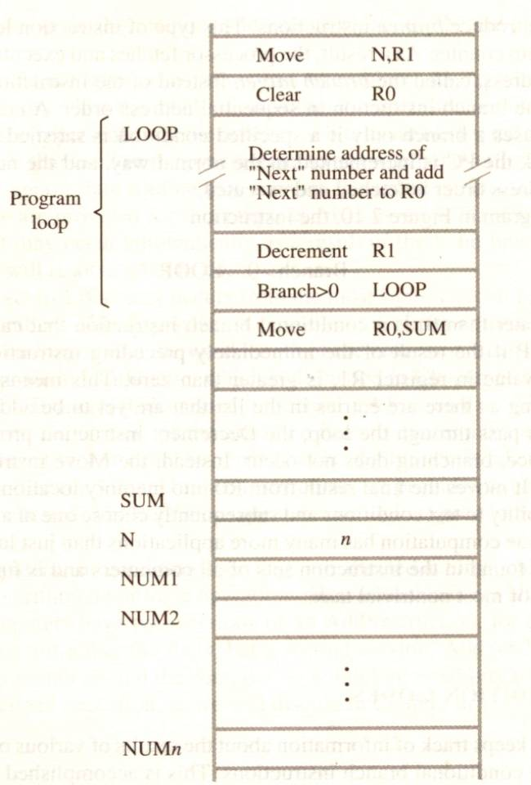
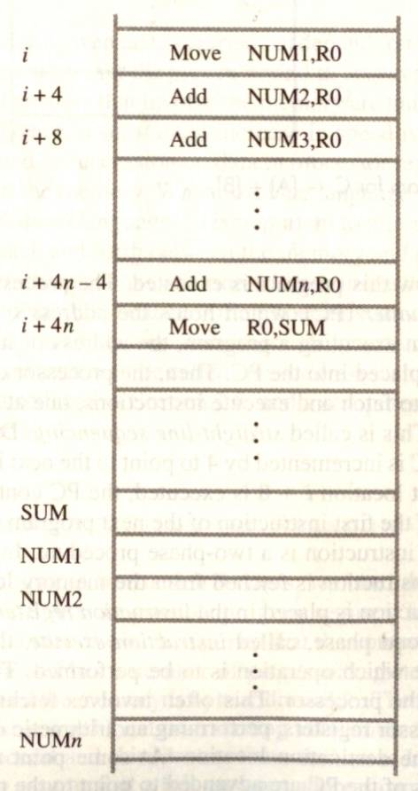
BRANCHING
A straight line program for adding n numbers
Using a loop to add n numbers

Slide 59
BRANCHING
Branch instruction are those which changes the normal sequence of execution.
Sequence can be changed either conditionally or unconditionally.
Accordingly we have conditional branch instructions and unconditional branch instruction.
Conditional branch instruction changes the sequence only when certain conditions are met.
Unconditional branch instruction changes the sequence of execution irrespective of condition of the results.

Slide 60
CONDITION CODES
CONDITIONAL CODE FLAGS: The processor keeps track of information about the results of various operations for use by subsequent conditional branch instructions
N – Negative 1 if results are Negative
0 if results are Positive
Z – Zero 1 if results are Zero
0 if results are Non zero
V – Overflow 1 if arithmetic overflow occurs
0 non overflow occurs
C – Carry 1 if carry and from MSB bit
0 if there is no carry from MSB bit

Slide 61
Conditional Branch Instructions
A: 1 1 1 1 0 0 0 0
Example:
A: 1 1 1 1 0 0 0 0
B: 0 0 0 1 0 1 0 0
+(−B): 1 1 1 0 1 1 0 0
1 1 0 1 1 1 0 0
C = 1
Z = 0
S = 1
V = 0

Slide 62
Overflow occurs when the magnitude of a number exceeds the range allowed by the size of the bit field

Slide 63
Status Bits
C_{n-1}
A
B
C_{n}
ALU
F
V
Z
S
C
F_{n-1}
Zero Check

Slide 64
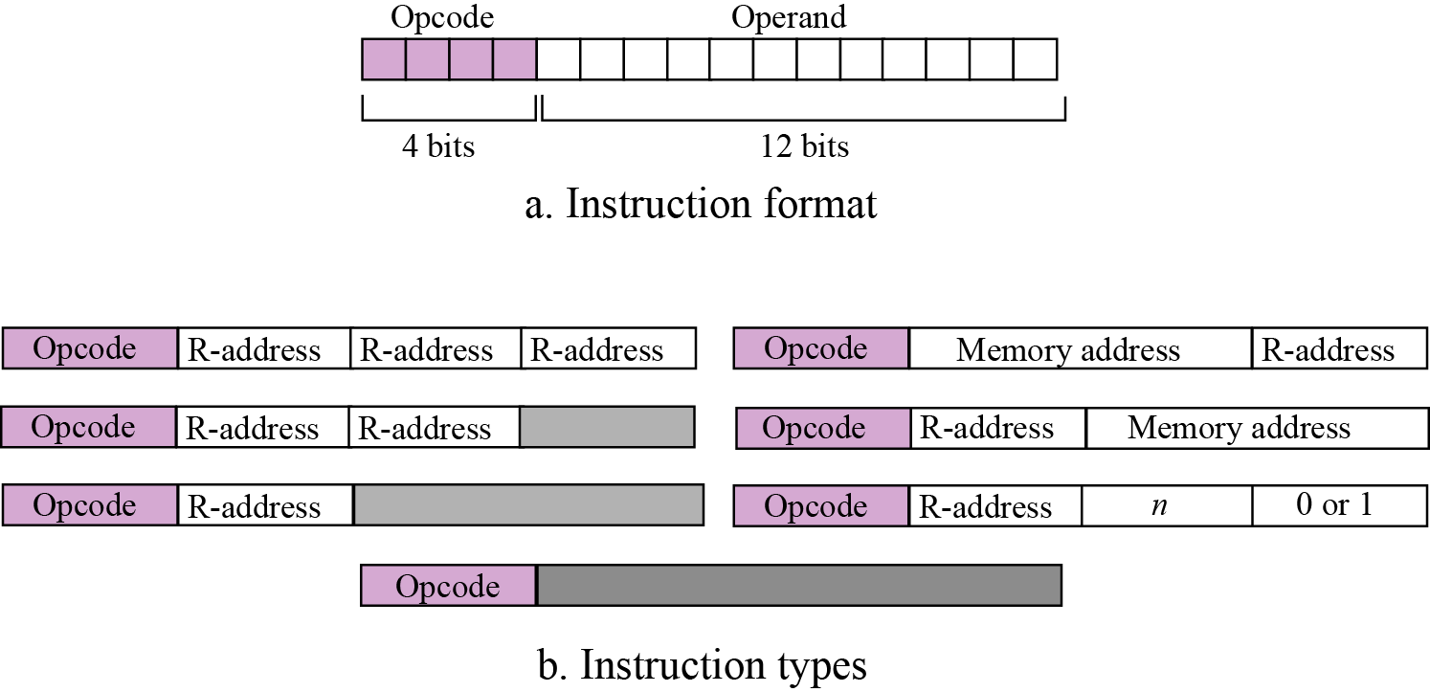
Figure Format and different instruction types

Slide 65
Processing the instructions
Simple computer, like most computers, uses machine cycles.
A cycle is made of three phases: fetch, decode and execute.
During the fetch phase, the instruction whose address is determined by the PC is obtained from the memory and loaded into the IR. The PC is then incremented to point to the next instruction.
During the decode phase, the instruction in IR is decoded and the required operands are fetched from the register or from memory.
During the execute phase, the instruction is executed and the results are placed in the appropriate memory location or the register.
Once the third phase is completed, the control unit starts the cycle again, but now the PC is pointing to the next instruction.
The process continues until the CPU reaches a HALT instruction.

Slide 66
Types of Addressing Modes
The different ways in which the location of the operand is specified in an instruction are referred to as addressing modes
Immediate Addressing
Direct Addressing
Indirect Addressing
Register Addressing
Register Indirect Addressing
Relative Addressing
Indexed Addressing

Slide 67
Immediate Addressing
Operand is given explicitly in the instruction
Operand = Value
e.g. ADD 5
Add 5 to contents of accumulator
5 is operand
No memory reference to fetch data
Fast
Limited range
Instruction
opcode
operand

Slide 68
Direct Addressing
Address field contains address of operand
Effective address (EA) = address field (A)
e.g. ADD A
Add contents of cell A to accumulator
Look in memory at address A for operand
Single memory reference to access data
No additional calculations to work out effective address
Limited address space

Slide 69
Direct Addressing Diagram
Instruction
Opcode
Address A
Memory
Operand
Notes:
6

Slide 70
Indirect Addressing (1)
Memory cell pointed to by address field contains the address of (pointer to) the operand
EA = [A]
Look in A, find address (A) and look there for operand
e.g. ADD (A)
Add contents of cell pointed to by contents of A to accumulator
Notes:
7

Slide 71
Indirect Addressing (2)
Large address space
2^{n} where n = word length
May be nested, multilevel, cascaded
e.g. EA = (((A)))
Draw the diagram yourself
Multiple memory accesses to find operand
Hence slower
Notes:
8

Slide 72
Indirect Addressing Diagram
Instruction
Opcode
Address A
Memory
Pointer to operand
Operand
Notes:
9

Slide 73
Register Addressing (1)
Operand is held in register named in address field
EA = R
Limited number of registers
Very small address field needed
Shorter instructions
Faster instruction fetch
Notes:
10

Slide 74
Register Addressing (2)
No memory access
Very fast execution
Very limited address space
Multiple registers helps performance
Requires good assembly programming or compiler writing
Notes:
11

Slide 75
Register Addressing Diagram
Instruction
Opcode
Register Address R
Registers
Operand
Notes:
12

Slide 76
Register Indirect Addressing
C.f. indirect addressing
EA = [R]
Operand is in memory cell pointed to by contents of register R
Large address space (2^{n})
One fewer memory access than indirect addressing
Notes:
13

Slide 77
Register Indirect Addressing Diagram
Instruction
Opcode
Register Address R
Memory
Registers
Pointer to Operand
Operand
Notes:
14

Slide 78
Indexed Addressing
EA = X + [R]
Address field hold two values
X = constant value (offset)
R = register that holds address of memory locations
or vice versa
(Offset given as constant or in the index register)
Add 20(R1),R2 or Add 1000(R1),R2
Notes:
15

Slide 79
Indexed Addressing Diagram
Instruction
Opcode
Register R
Constant Value
Memory
Registers
Pointer to Operand
+
Operand
Notes:
16

Slide 80
Relative Addressing
A version of displacement addressing
R = Program counter, PC
EA = X + (PC)
i.e. get operand from X bytes away from current location pointed to by PC
c.f locality of reference & cache usage
Notes:
17

Slide 81
Auto increment mode
The effective address of the operand is the contents of a register specified in the instruction.
After accessing the operand, the contents of this register are automatically incremented to point to the next item in the list
EA=[Ri]; Increment Ri ---- (Ri)+
Eg: Add (R2)+,R0

Slide 82
Auto decrement mode
The contents of a register specified in the instruction are first automatically decremented and are then used as the effective address of the operand
Decrement Ri; EA= [Ri] ----- -(Ri)

